Slide 1


SHARED INTEREST SOCIETY
Justice, not profit is our bottom line
www.shared-interest.com
Notes:
You will have noticed that both your mic and camera is switched off.
If you move your mouse to the bottom of the screen you will see an icon that says Q&A. If you click on this it will bring up a box

Slide 2




BACKGROUND
Founded in 1990
Not for profit organisation
Headquarters in UK with a regional presence in Kenya, Ghana, Peru and Costa Rica
37 Colleagues
Fair trade supporter and a WFTO member
3 Queen’s Award and King's Award for Enterprise in Sustainable Development in 2025

Slide 3

WHAT WE DO

Slide 4
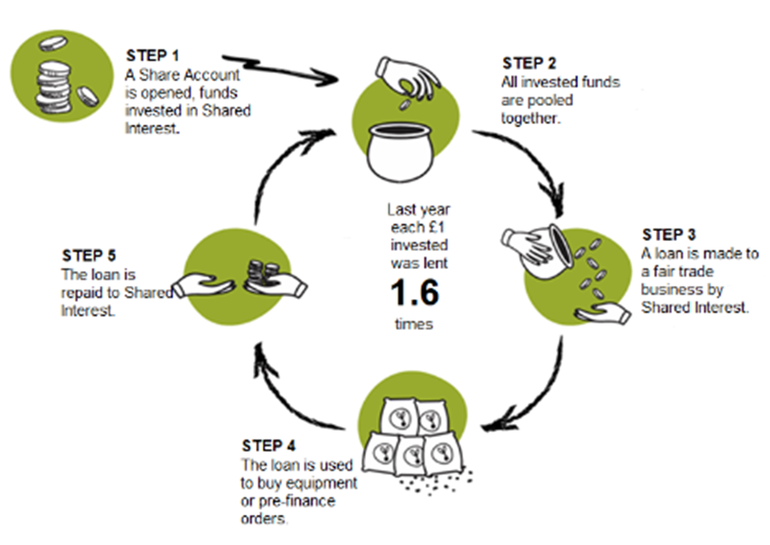

HOW IT WORKS

Slide 5
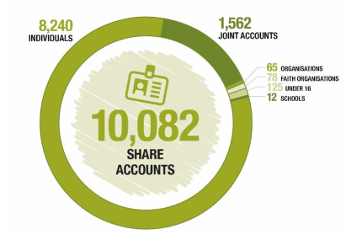
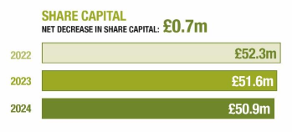
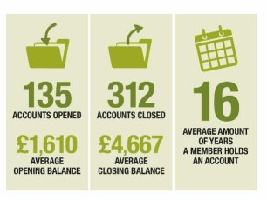
OUR INVESTORS
Each member has an equal voice
Average length of membership is 16 years
Members invest for social return
Members share the risk
Notes:
If you move your mouse to the bottom of the screen you will see an icon that says Q&A. If you click on this it will bring up a box

Slide 6
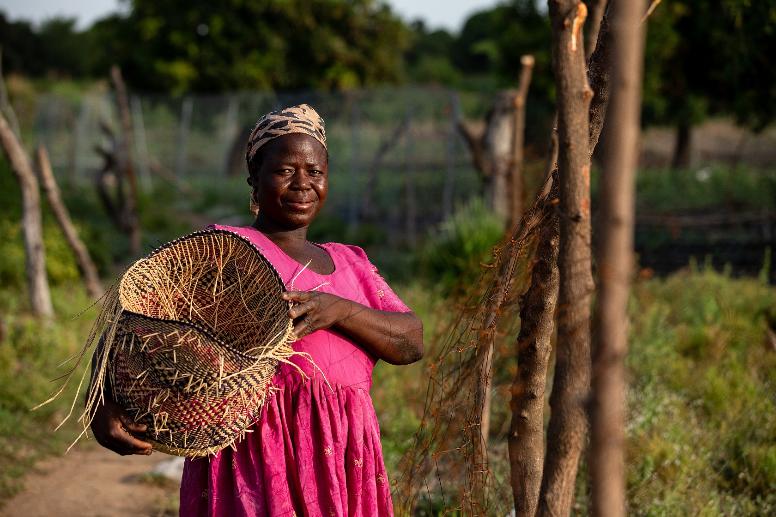
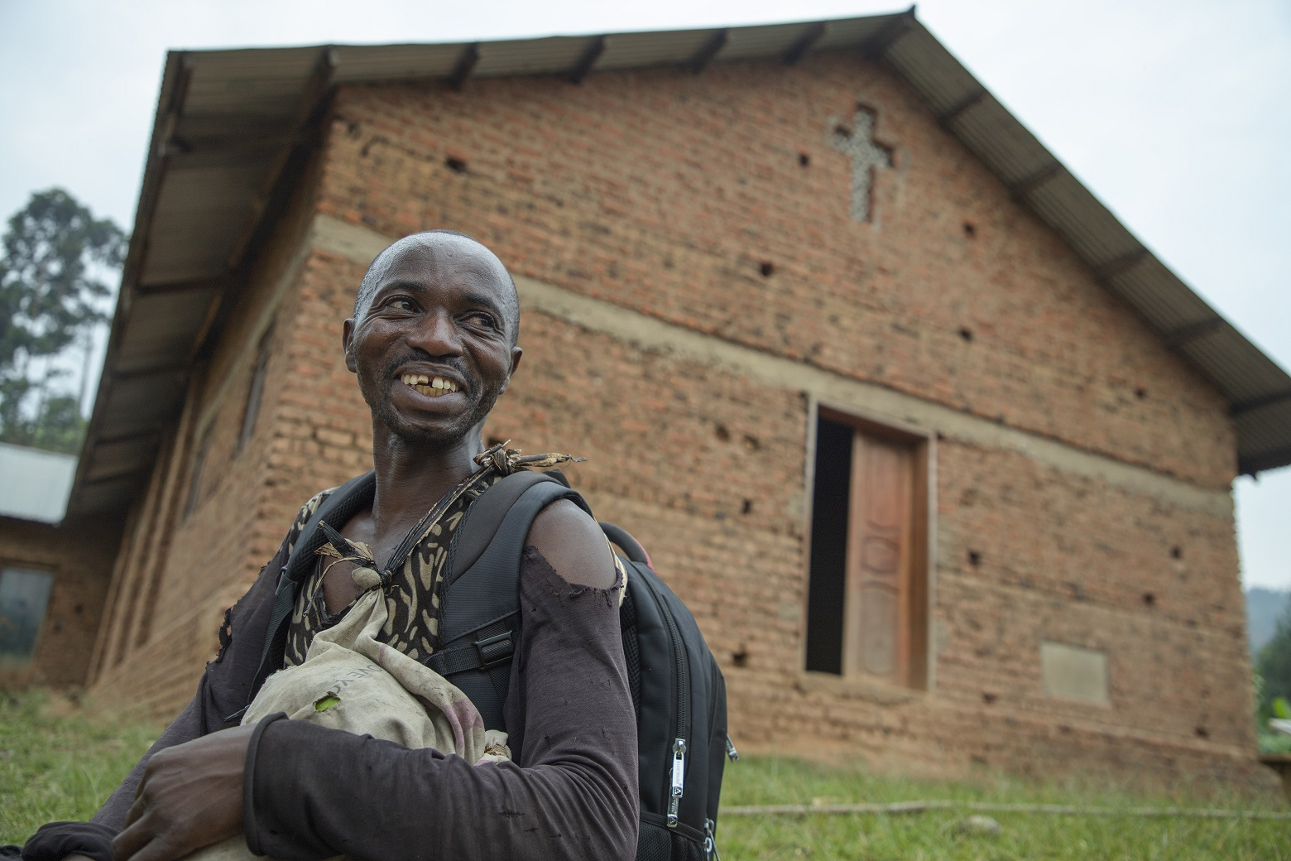
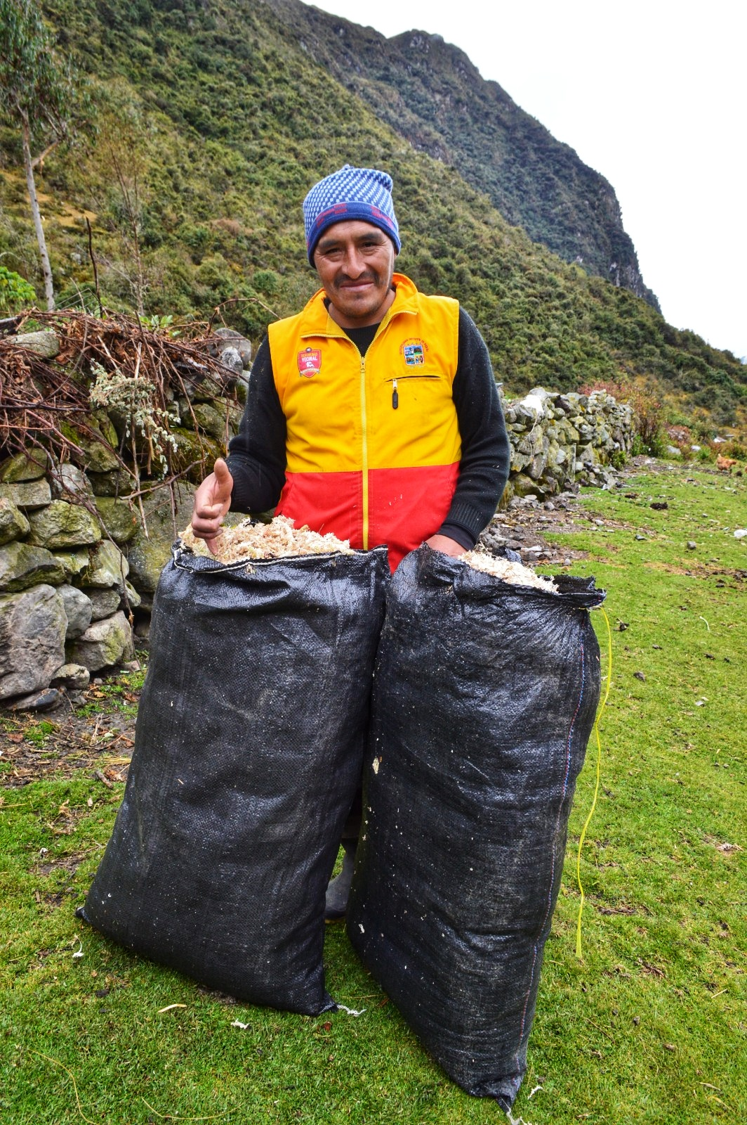
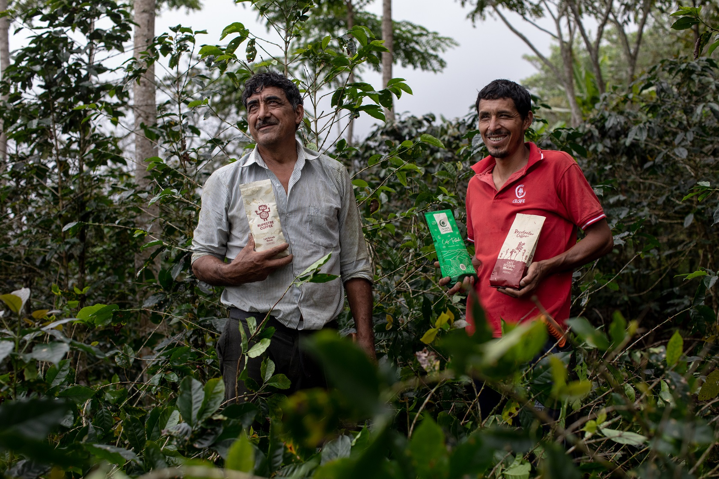
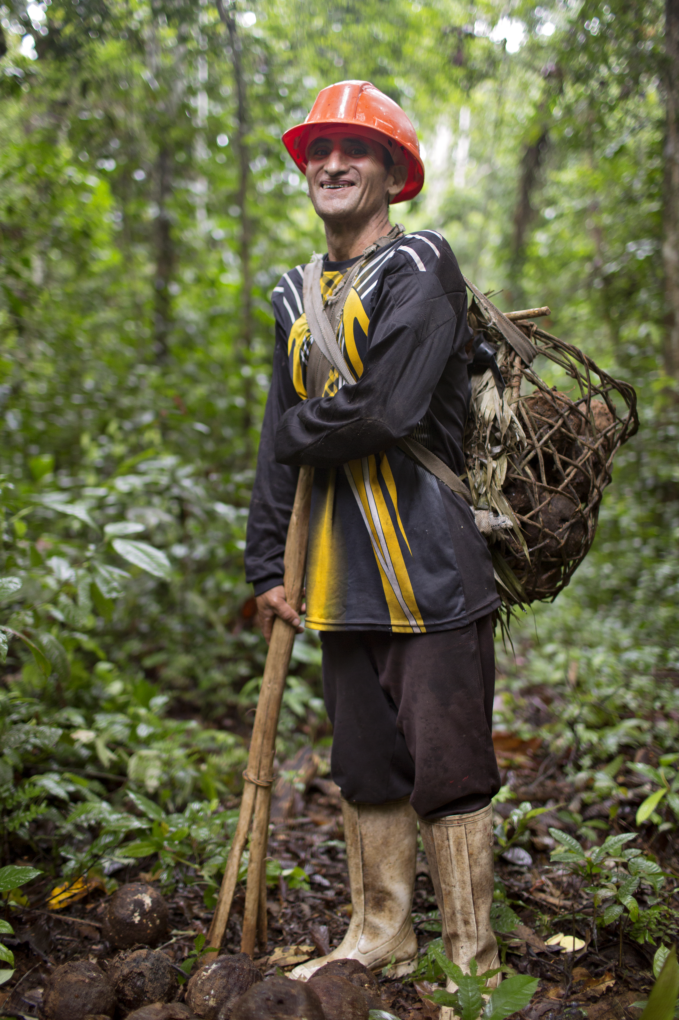

166 CUSTOMERS

Slide 7

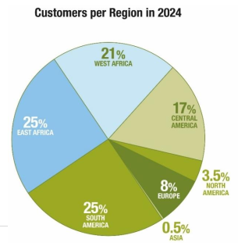

CUSTOMER PORTFOLIO

Slide 8
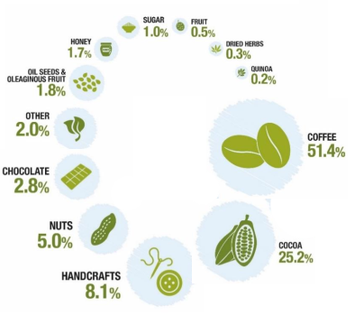
PRODUCT PORTFOLIO
www.shared-interest.com
www.shared-interest.com

Slide 9
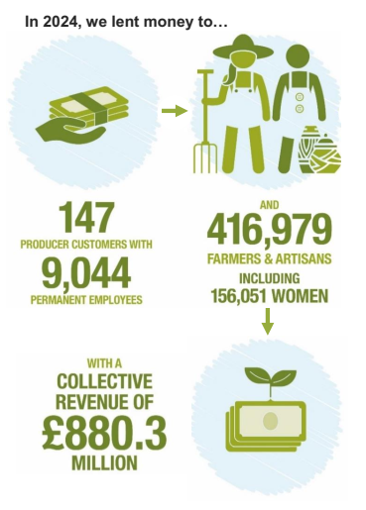
OUR IMPACT

Slide 10

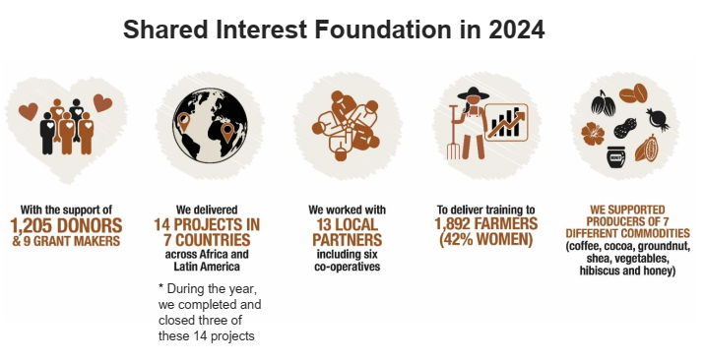

OUR CHARITABLE ARM
Aim: To improve livelihoods through the development of sustainable businesses.
Established in 2004
International development charity
Charity Times Award Winner
Producer training and other
producer focused projects
Funded by grants and donations
from members and other individuals

Slide 11

Any questions?
www.shared-interest.com

